Slide 1
scRNA-seq Analysis
CDS-SR scRNA-seq Workshop 2022
(Part 1)
Introduction and CellRanger (Alignment and Quantification)
Slide 1

Slide 2
Common Tools Used for Analysis
There is not just one best tool to analyze scRNA-seq
There are many tools!
https://www.scrna-tools.org/
New tools come out all the time!
Depends on:
Accessibility (within and between tool)
Documentation
Coding Language (R, Python, bash, etc.)
CPU and memory usage
Slide 2

Slide 3
Common Tools Used for Analysis
BCL/FASTQ -> Counts
CellRanger (bash)
Will go over this tool since AGC uses this
Counts -> Downstream Analysis
Seurat (R), Monocle (R), scanpy (python), etc.
Will go over my own customized pipeline using Seurat
Slide 3

Slide 4
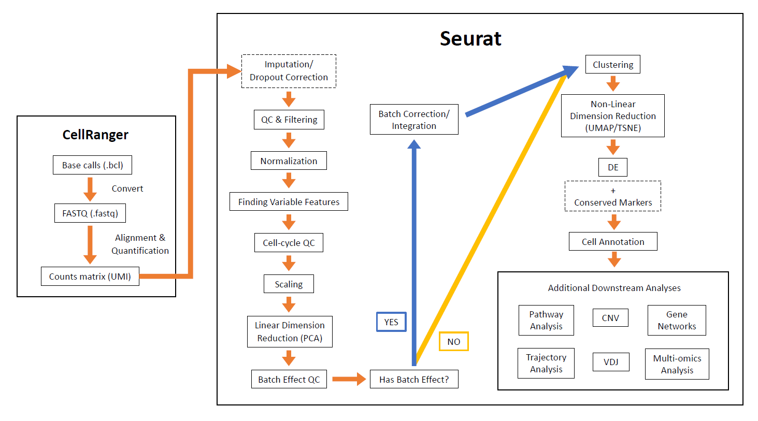
Full Analysis Pipeline
Slide 4

Slide 5
Full Analysis Pipeline
Slide 5

Slide 6
CellRanger: What Is It?
Analysis pipeline that processes 10X Genomics scRNA-seq data
Align reads, generate feature-barcode (counts) matrices, etc.
Can do other downstream analyses (ex: clustering, dimension reduction, etc.) but with some limitations
Can’t do:
Batch correction/integration
Specialized downstream analyses (ex: pathway analysis, trajectory analysis, etc.)
Will focus on processing raw calls/reads to counts
AGC runs and gives files for this part
Slide 6

Slide 7
CellRanger: Steps
Convert base calls (BCL) to reads (FASTQ)
Can demultiplexes if have multiplexed samples
mkfastq command
Wrapper function of Illumina’s bcl2fastq function
CellRanger
Base calls (.bcl)
Convert
FASTQ (.fastq)
Alignment & Quantification
Counts matrix (UMI)
Slide 7

Slide 8
CellRanger: Steps
Align reads and quantify to calculate counts
count or multi command
multi is for multiplexed samples
Filters multiplets and blanks from data
Counts are UMI
UMI = Unique Molecular Identifier
Counts are corrected for errors
Library preparation, target enrichment, sequencing, etc.
CellRanger
Base calls (.bcl)
Convert
FASTQ (.fastq)
Alignment & Quantification
Counts matrix (UMI)
Slide 8

Slide 9
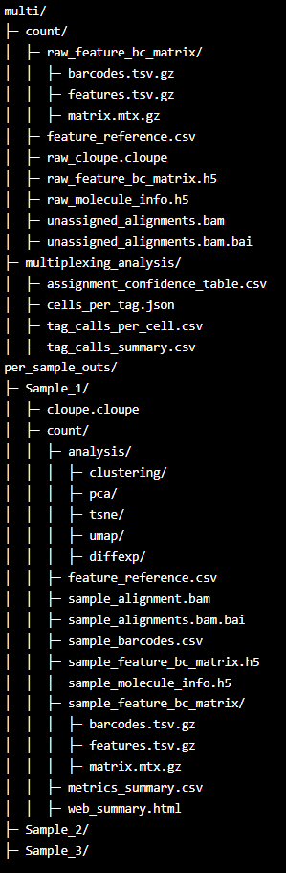
Output of CellRanger
Slide 9

Slide 10
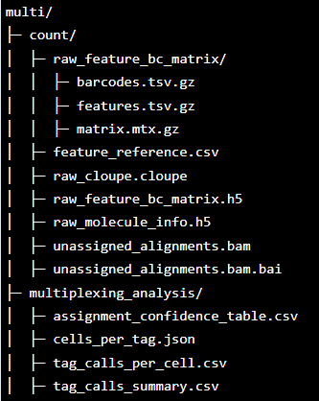
Output of CellRanger: multi (folder)
raw_feature_bc_matrix (folder)
Not filtered counts matrix
Should contain “barcodes”, “features”, and “matrix” .gz files
for older versions of CellRanger, might have “genes.tsv.gz”
can just change to “features”
raw_feature_bc_matrix.h5
Not filtered counts matrix
Like the folder, but more compact
multiplexing_analysis (folder)
Contains info about demultiplexing
Slide 10

Slide 11
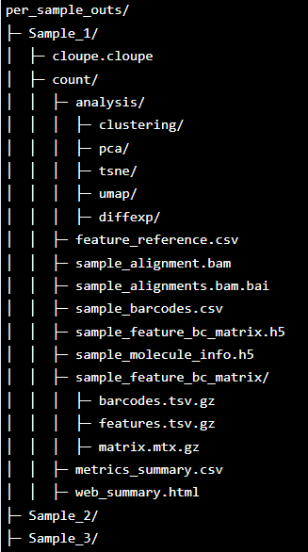
Output of CellRanger: per_sample_outs (folder)
cloupe.cloupe
Loupe Browser analysis file
sample_feature_bc_matrix (folder)
Filtered counts matrix
Contains only detected cell-associated barcodes in MEX format
Should contain “barcodes”, “features”, and “matrix” .gz files
might also be called “filtered_feature_bc_matrix”
sample_feature_bc_matrix.h5
Filtered counts matrix
Like the folder, but more compact
web_summary.html
summary metrics and charts in HTML format
good way to check if sequencing went well
Slide 11

Slide 12
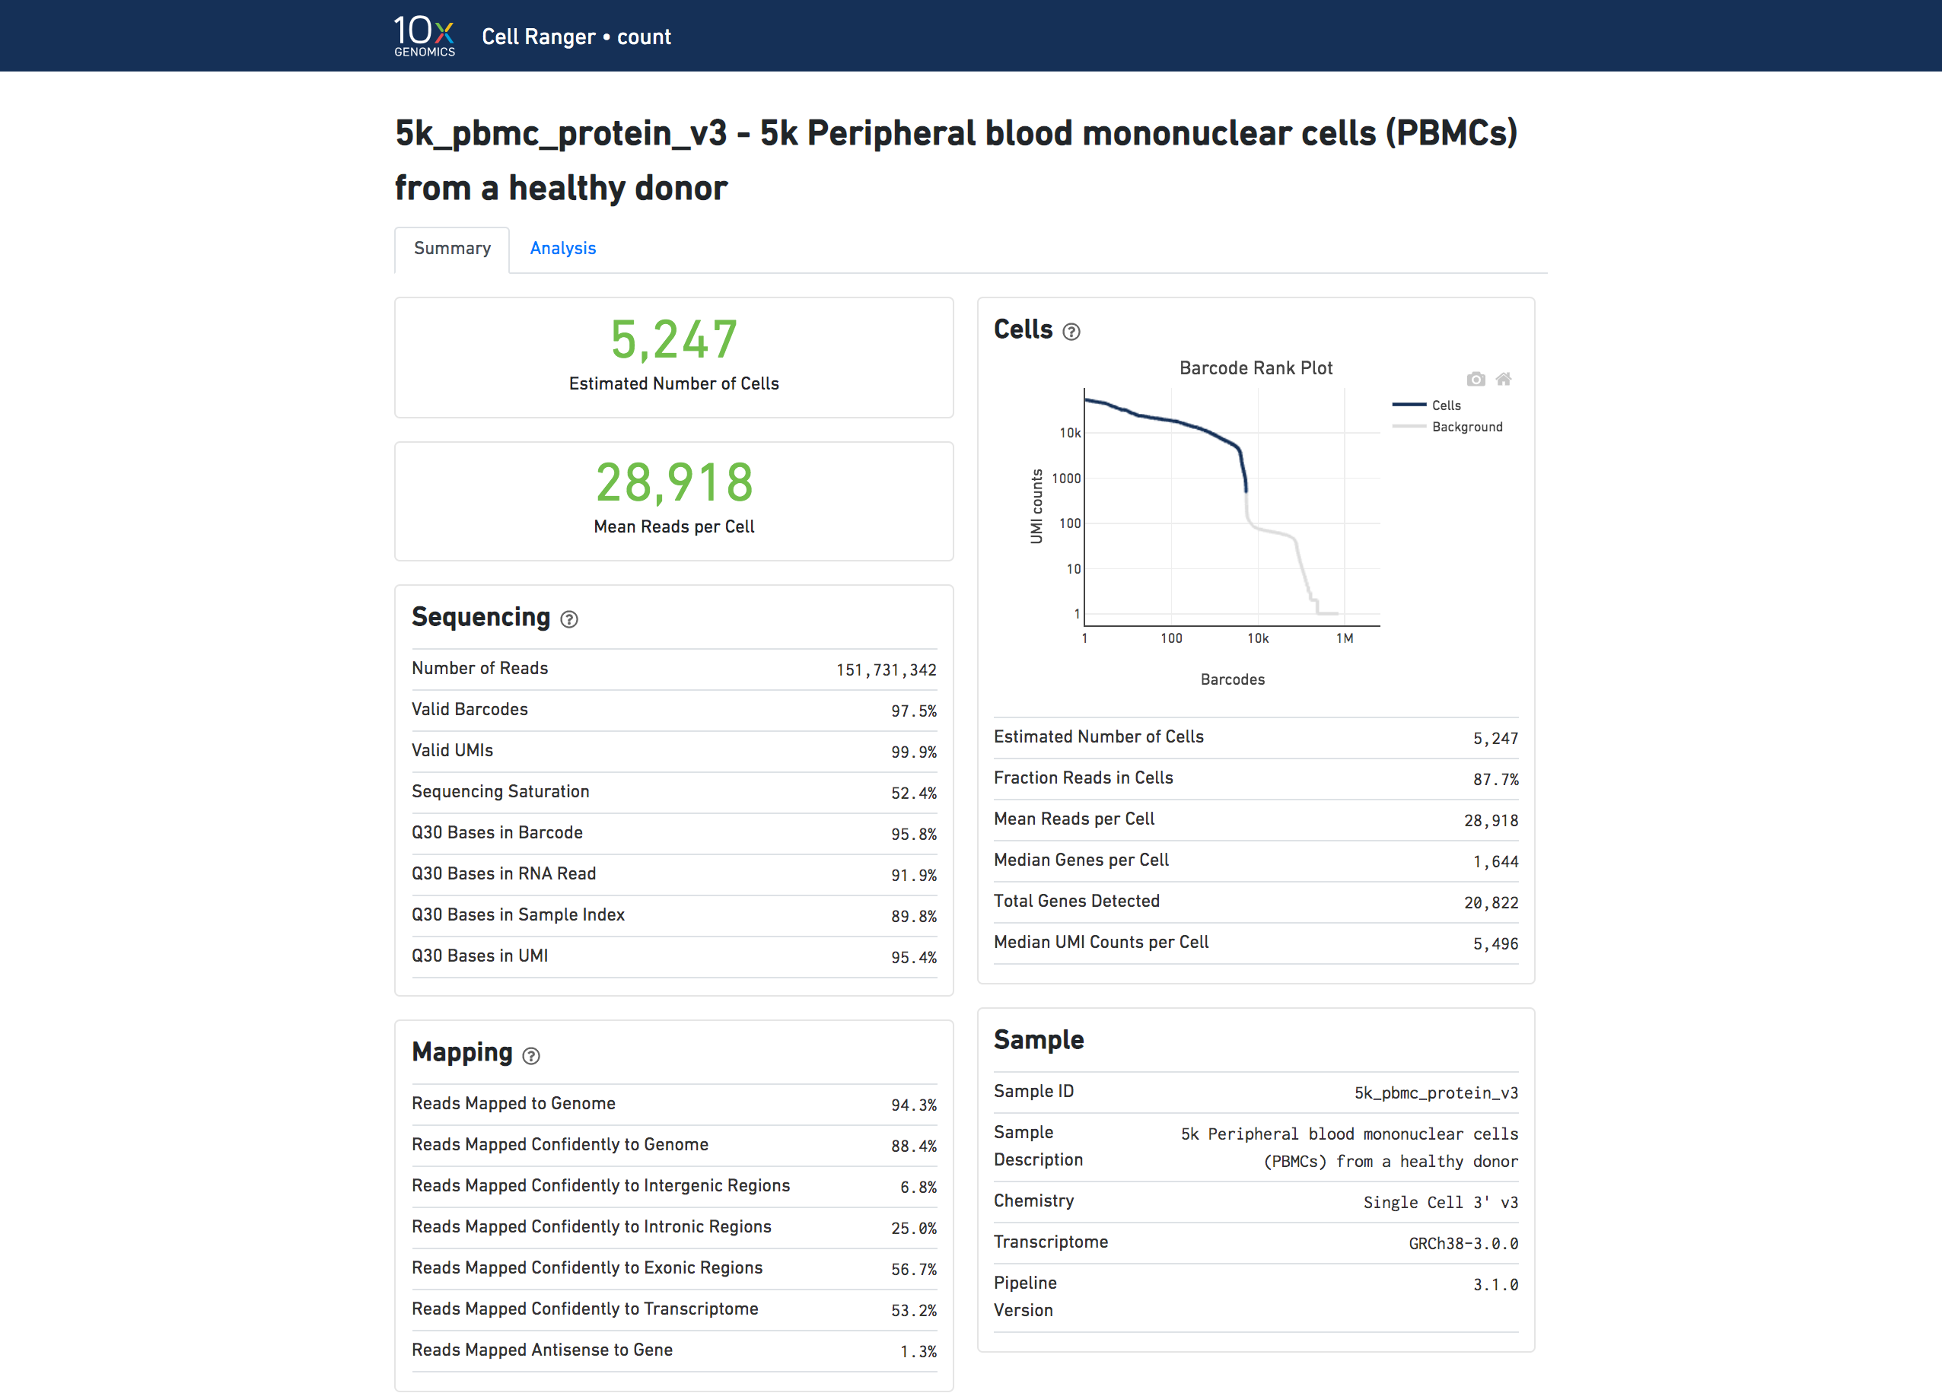
Output of CellRanger: web_summary.html
https://support.10xgenomics.com/single-cell-gene-expression/software/pipelines/latest/output/summary
Slide 12

Slide 13
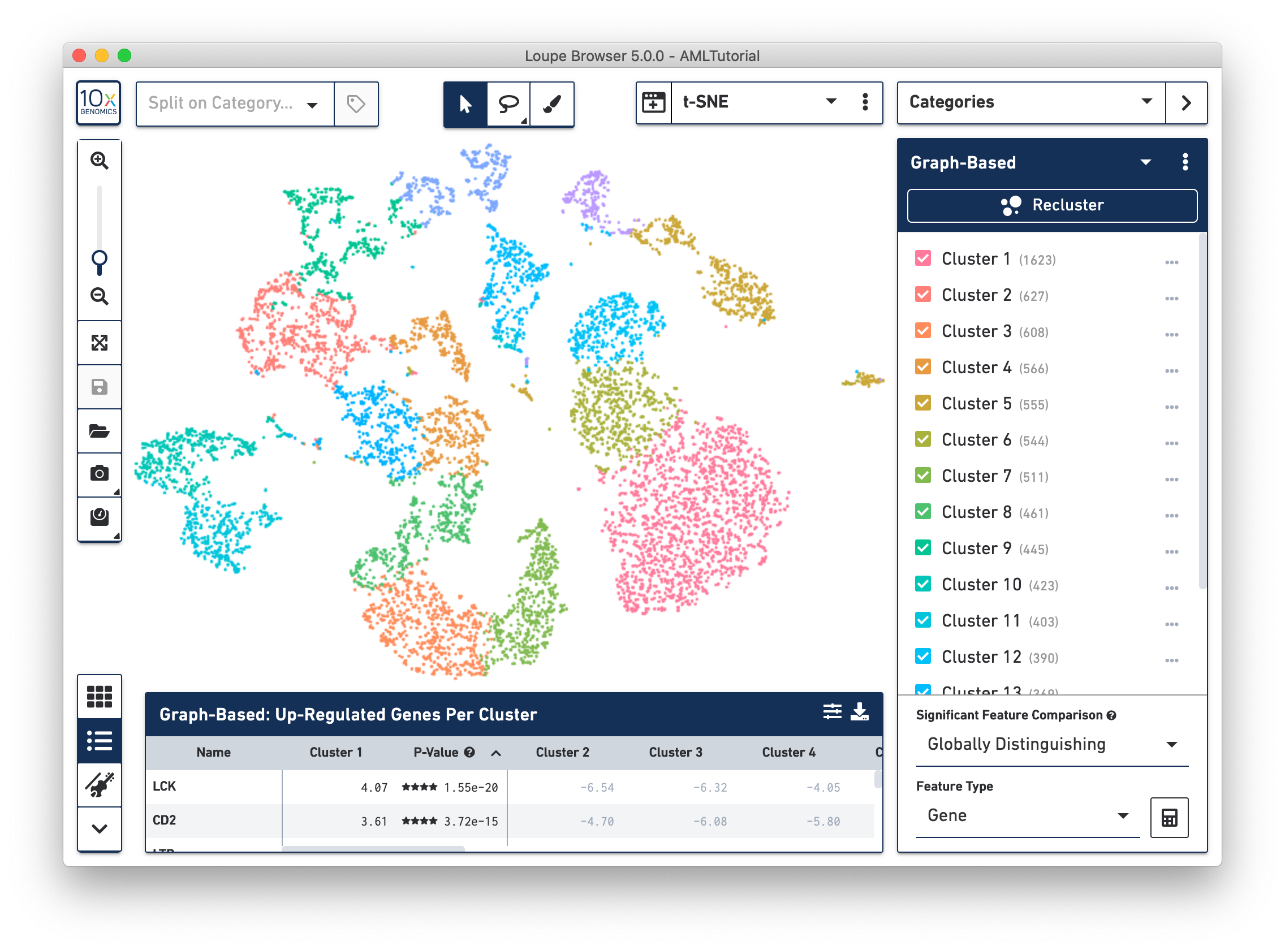
Output of CellRanger: Loupe Browser
Slide 13
https://support.10xgenomics.com/single-cell-gene-expression/software/visualization/latest/what-is-loupe-cell-browser

Slide 14
FAQ
It looks like the AGC does all the analysis for me and I can merge the samples together. Do I need to do further analyses?
Not necessarily!
Can just use Loupe Browser
Some things to think about:
Do you have a batch effect in your dataset?
Do you want to do other downstream analyses (pathway, trajectory, other visualizations, etc.)
Slide 14

Slide 15
FAQ
I want to use the data from this and do further analyses outside of CellRanger. Which files do I need?
counts matrix (folder or .h5)
raw vs. filtered matrix
filtered matrix is usually a good point to start at
can use raw matrix, but will have to do further filtering
folder vs. .h5 file
depends on your preference
only have to import one file for each sample for downstream analyses
Slide 15

Slide 16
FAQ
I have specific genes that are not found in the reference genome file that is used to align my reads. Can I include these genes?
You can! But it takes a bit more work…
Will have to re-run alignment and quantification
Look at supplemental documents included in workshop and CellRanger documentation
Slide 16

Slide 17
CellRanger: Additional Resources
CellRanger Manual: https://support.10xgenomics.com/single-cell-gene-expression/software/pipelines/latest/what-is-cell-ranger
Specific topics
BCL to FASTQ conversion: https://support.illumina.com/content/dam/illumina-support/documents/documentation/software_documentation/bcl2fastq/bcl2fastq_letterbooklet_15038058brpmi.pdf
Structure of FASTQ file: https://support.illumina.com/bulletins/2016/04/fastq-files-explained.html
Demultiplexing with bcl2fastq: https://support.10xgenomics.com/single-cell-gene-expression/software/pipelines/latest/using/bcl2fastq-direct
Alignment and Quantification: https://support.10xgenomics.com/single-cell-gene-expression/software/pipelines/latest/algorithms/overview
multi function: https://support.10xgenomics.com/single-cell-gene-expression/software/pipelines/latest/algorithms/cellplex
Loupe Browser: https://support.10xgenomics.com/single-cell-gene-expression/software/visualization/latest/what-is-loupe-cell-browser
Web summary file: https://support.10xgenomics.com/single-cell-gene-expression/software/pipelines/latest/output/summary
Build custom reference = https://support.10xgenomics.com/single-cell-gene-expression/software/pipelines/latest/using/tutorial_mr
For more questions about delivery of data or what analysis is done in CellRanger, contact AGC!
https://brcf.medicine.umich.edu/cores/advanced-genomics/
Slide 17

